Slide 1

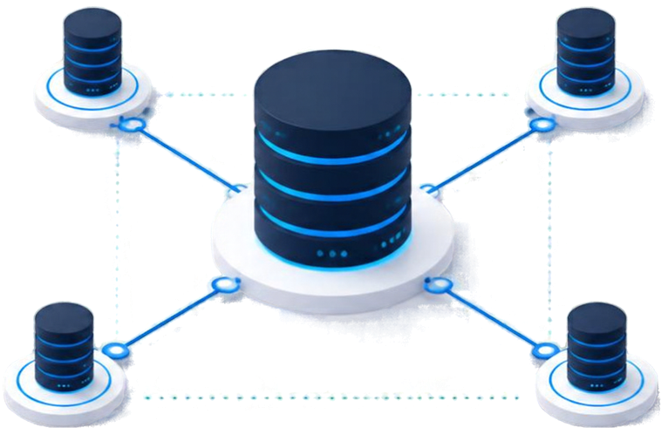

COMPUTER INSTITUTE
MANAGEMENT SYSTEM
Database Management Systems | LCA 3
Pranavi Joshi
1262242691
TY ECE AIML C
G3

Slide 2


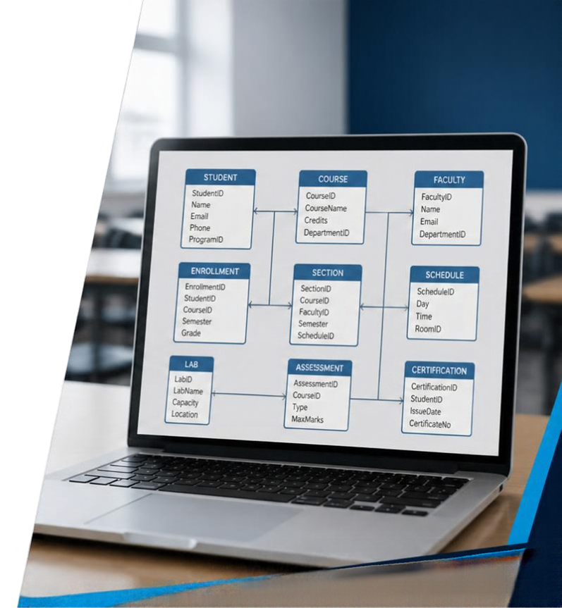

PROBLEM &
OBJECTIVE
Institute information is scattered across student records, courses, faculty, scheduling, labs, and assessment.
Centralized relational storage
Repeatable admission-to-certification workflows
Reduced redundant data entry
Transparent dashboard reporting

Slide 3










TECHNOLOGY & ARCHITECTURE
BROWSER UI
FLASK APP
MYSQL DATABASE
Python routes
Forms & business logic
Renders tables / views
HTML/CSS
Jinja2 templates
HTTP
GET / POST
DB CONNECTION
mysql-connectorpython
ComputerInstituteDB
Python-dotenv loads credentials from .env file
Flask handles GET views and POST create operations
Server executes SQL queries and renders tables
System not deployed publicly
A secure, modular architecture for managing institute data and workflows.

Slide 4



























10 APPLICATION
MODULES
Ten database-backed business modules shown on the dashboard.
DASHBOARD OVERVIEW
Student
Course
Faculty
Laboratory
Batch
MASTER DATA
MASTER DATA
ACADEMIC OPERATIONS
ASSESSMENT
1,284
156
89
42
64
Student
Laboratory
Batch
Examination
Enrollment
Lab Allocation
Examination
Result
Certificate
Course
Enrollment
Result
3,412
128
356
2,987
1,743
Faculty
Lab Allocation
Certificate
DASHBOARD OVERVIEW
Real-time counts and insights for all modules

Slide 5
















DATA MODEL /
ENTITY RELATIONSHIPS
COURSE
M
BATCH
M
FACULTY
Course_ID
Batch_ID
Faculty_ID
M
M
STUDENT
LABORATORY
Student_ID
Lab_ID
M
M
M
M
ENROLLMENT
M
EXAMINATION
M
LAB ALLOCATION
Enrollment_ID
Exam_ID
Lab Allocation_ID
M
M
RESULT
Result_ID
M
CERTIFICATE
M
Certificate_ID
Relationships inferred from SQL joins and INSERT statements; DDL/foreign-key declarations not supplied.

Slide 6





















RELATIONAL
TABLE DESIGN
STUDENT
Student_ID, Student_Name,
Email, Phone, DOB
EXAMINATION
Exam_ID, Batch_ID, ExamDate,
Exam Type, Total_Marks
COURSE
Course_ID, Course_Name,
Duration, Fees
RESULT
Result_ID, Exam_ID, Student_ID,
Marks, Status
Batch_ID, Course_ID, Faculty_ID,
StartDate, EndDate, Timing
Certificate_ID, Student_ID,
Course_ID, Issue Date,
Certificate_No
BATCH
CERTIFICATE
ENROLLMENT
Enrollment_ID, Student_ID,
Batch_ID, EnrollmentDate
FACULTY
Faculty_ID, Faculty_Name,
Email, Phone, Department
LAB ALLOCATION
Allocation_ID, Batch_ID, Lab_ID,
AllocationDate, Start Time, End Time
LABORATORY
Lab_ID, Lab_Name,
Capacity, Location
Note: Database primary key, foreign key relationships, and normalization constraints are not verified in the absence of DDL.

Slide 7



























CORE WORKFLOW
From student registration to certificate record
1
2
3
4
5
6
7
8
Create course and faculty
Assign faculty/course to batch
Enroll student into batch
Enter obtained marks
Create course certificate record
Record
a student
Schedule examination
Compute status
Certificate issuing form does NOT automatically check pass status.
No auto-awarding functionality. Results do not enforce certificate eligibility.

Slide 8







LAB & TIMETABLE
MANAGEMENT
Lab_ID, Lab_Name,
Capacity, Location
LABORATORY
Links Batch_ID to Lab_ID with Allocation,Date, Start Time, End Time
LAB ALLOCATION
Stores StartDate, EndDate, Timing, Course_ID, Faculty_ID
BATCH
SQL joins display named course, lab, and faculty instead of IDs
SMART QUERIES
IMPORTANT CAVEAT: No collision validation, capacity checks, or automated timetable conflict prevention. These are not implemented.

Slide 9




DBMS CONCEPTS
IN CODE
SELECT COUNT(*) FOR DASHBOARD COUNTS
INSERT INTO WITH %S
PARAMETER PLACEHOLDERS
SELECT Enrollment_ID, Student_Name, Course_Name
COMMIT TO PERSIST
NEW RECORDS
FROM ENROLLMENT E
ORDER BY FOR LISTINGS
JOIN STUDENT S ON E.STUDENT_ID = S.STUDENT_ID
New IDs generated via
JOIN BATCH B ON E.BATCH_ID = B.BATCH_ID
SELECT COALESCE(MAX(ID), 0)+1
WITH DIFFERENT STARTING OFFSETS
JOIN COURSE C ON BCOURSE_ID = CCOURSE_ID;
Routes support list and create operations only; no update or delete implemented

Slide 10








OUTCOME, LIMITATIONS
& NEXT STEPS
OUTCOME
LIMITATIONS
NEXT STEPS
Routes/forms lists for
10 management areas
SQL DDL and data absent from ZIP; schema constraints unverified
Implement SQL constraints and
auto-increment IDs
No edit or delete routes
Add input validation
Dashboard counts
Manual MAX+1 ID generation can collide under concurrent inserts
Role-based authentication
Relational joins
No validation of marks ≤ total, lab allocation overlaps, enrollment membership, or certificate eligibility
Editing and reporting functionality
Exam threshold logic
and certificate-entry form
Deployment hardening and security
Flask debug=True and no user
login in supplied code
This is a code-reviewed project,
not evidence of end-to-end database-run testing.

